Slide 1
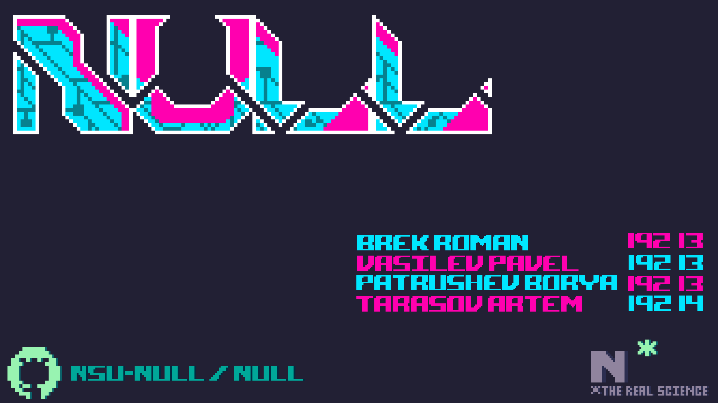


null
Brek Roman 19213
Vasilev Pavel 19213
Patrushev Borya 19213
Tarasov Artёm 19214
【=◈︿◈=】
nsu-null/null

Slide 2


Slide 3



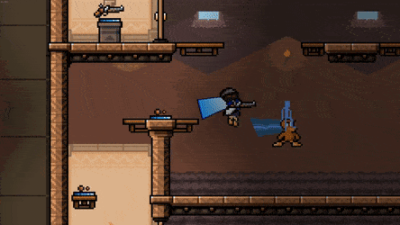




Dynamic 2d action pvp-multiplayer platformer with lots of fast rounds.
The environment in the game is dynamic and players can interact with it.
The game is located in cyberpunk setting, and the graphic style can be described as "pixel art".
There are augmentations on the map for characters("perk")
And the cyberpunk style is reflected in the style of the weapons, both melee and ranged.

Slide 4

Everything happens in the future(2288), where there are flying cars, augmentations, AI and e.t.c.
There are 2 casts: high and low
The protagonist is a member of the lower caste
His goal is to win the tournament and do justice

Slide 5


Slide 6
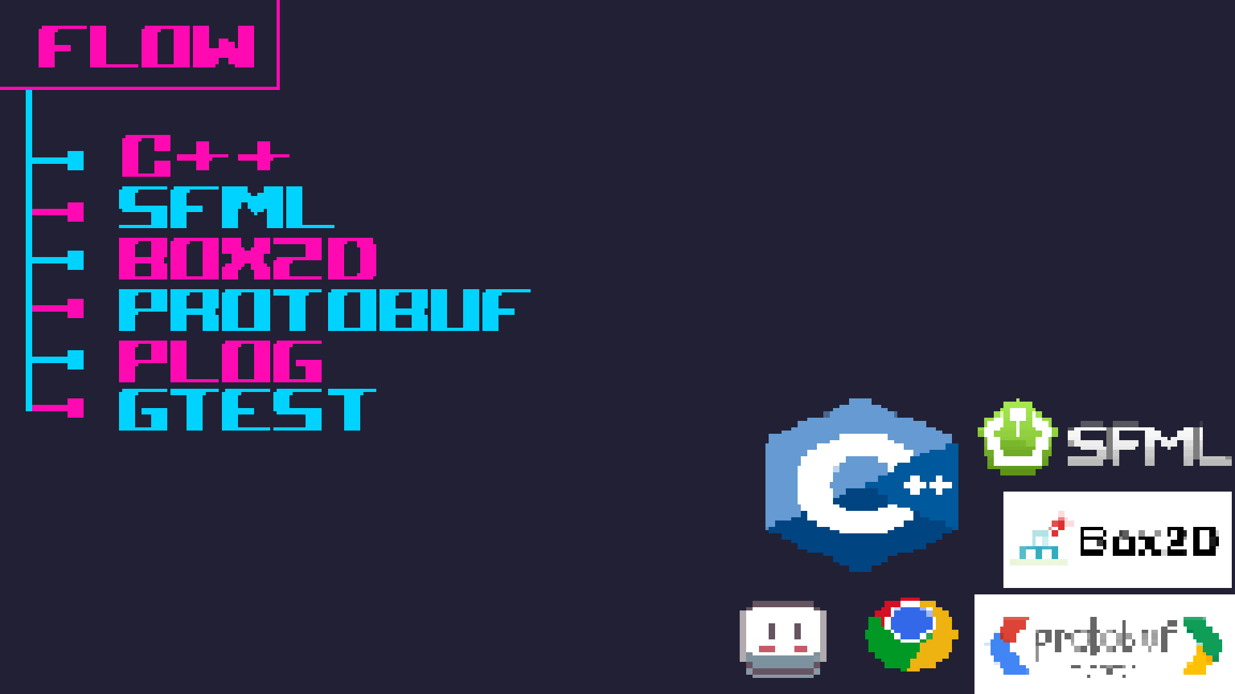

Slide 7
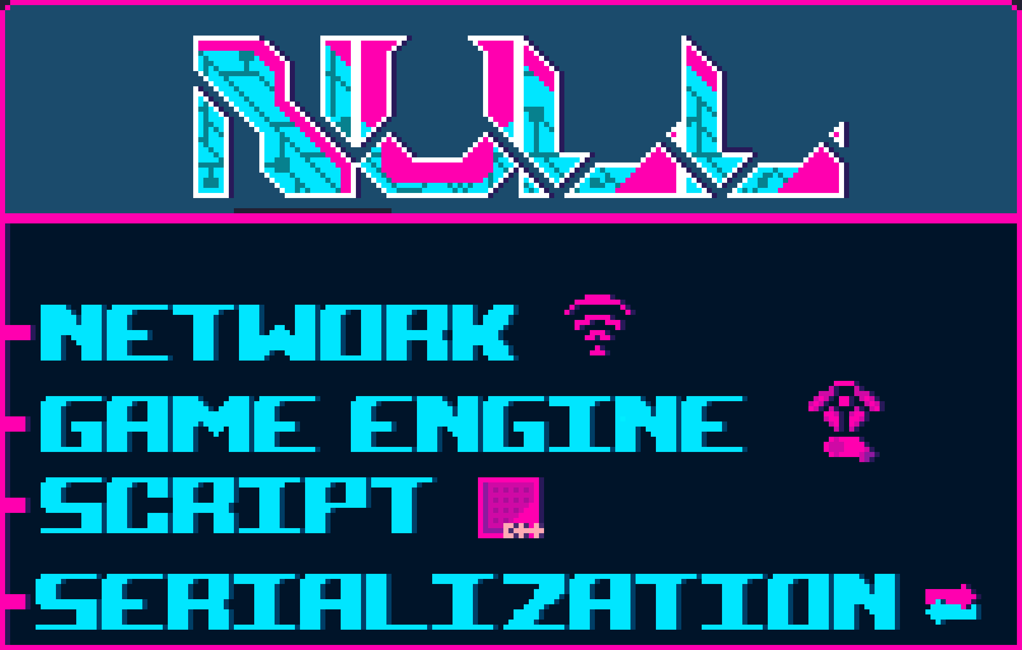

Slide 8


Slide 9
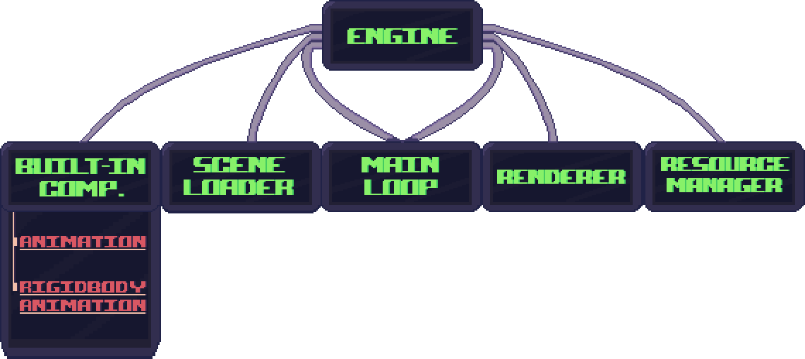

Slide 10
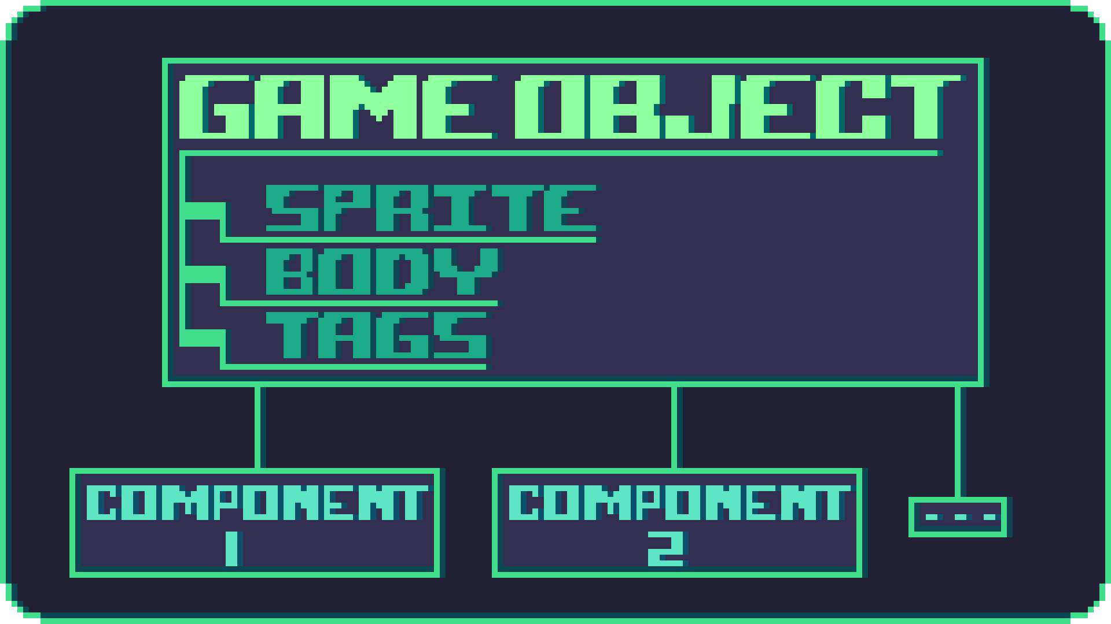

Slide 11
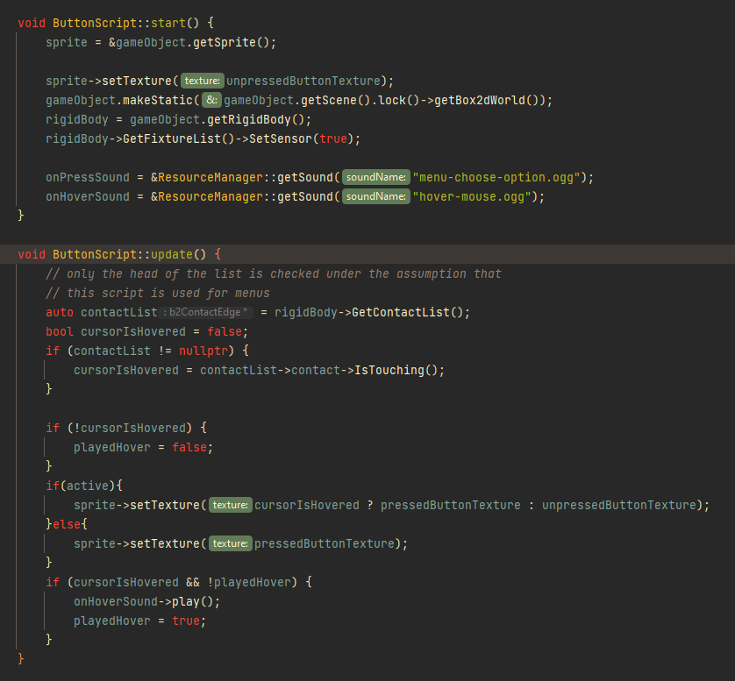

Slide 12
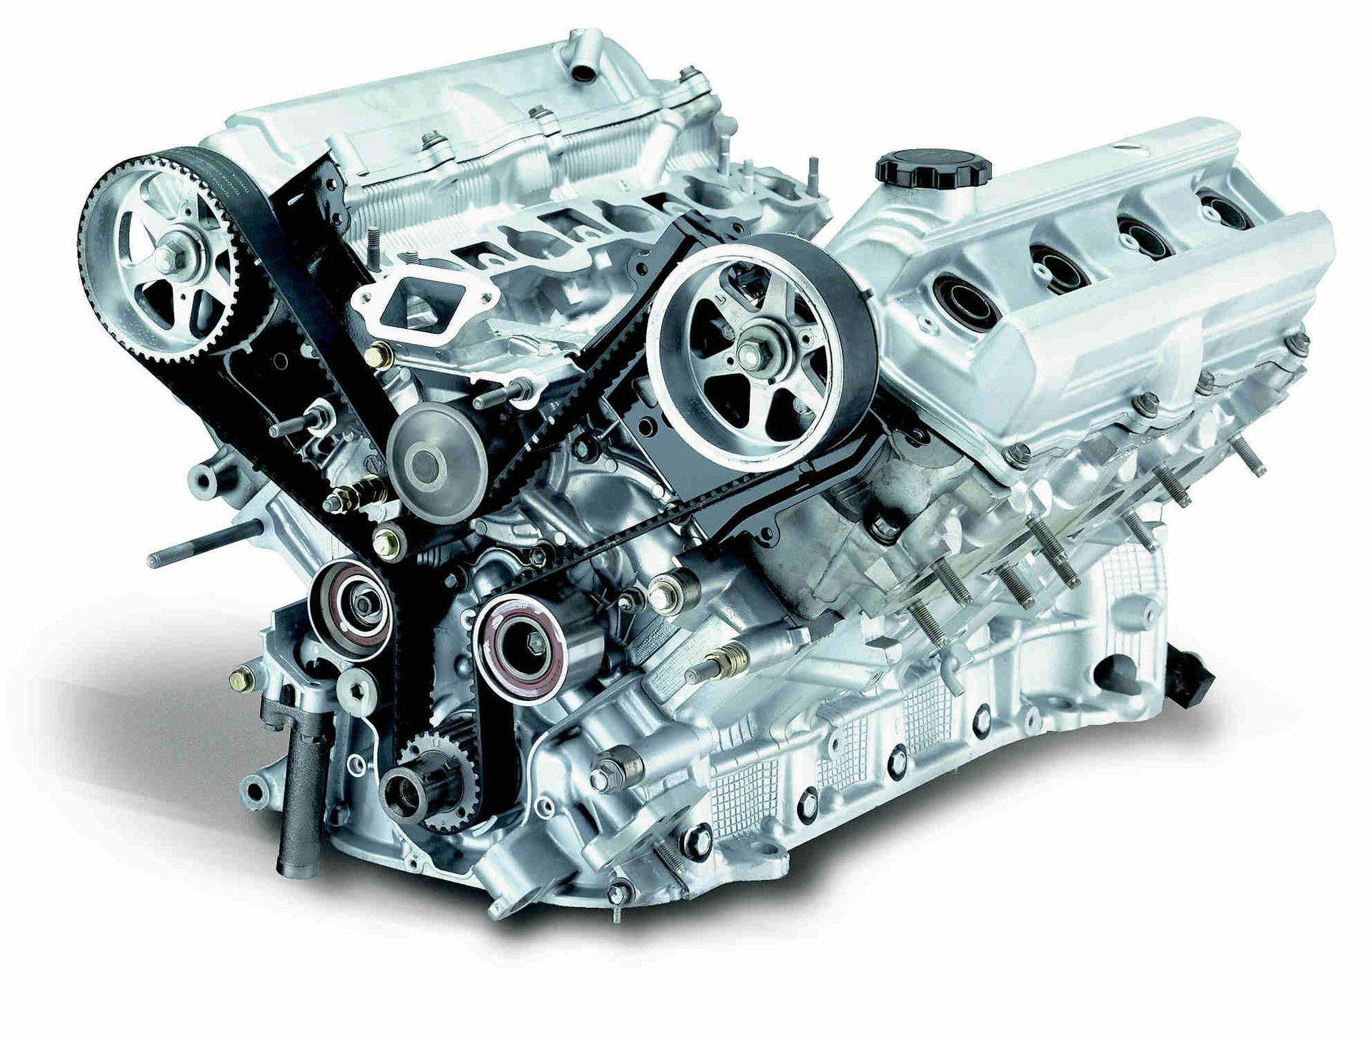
Scene (serializable piece of data which dictates what a game level is)
GameObject (serializable piece of data which dictates what a game level is )
Component (part of a GameObject which is aware of the scene and the event loop)
SceneLoader (singleton object / a set of functions in the global scope that can substitute the currently loaded scene for some other)
MainLoop (a singleton which takes care of updating the Scene)
Entity-Component pattern was widely used (for GameObject and Component relationship)

Slide 14
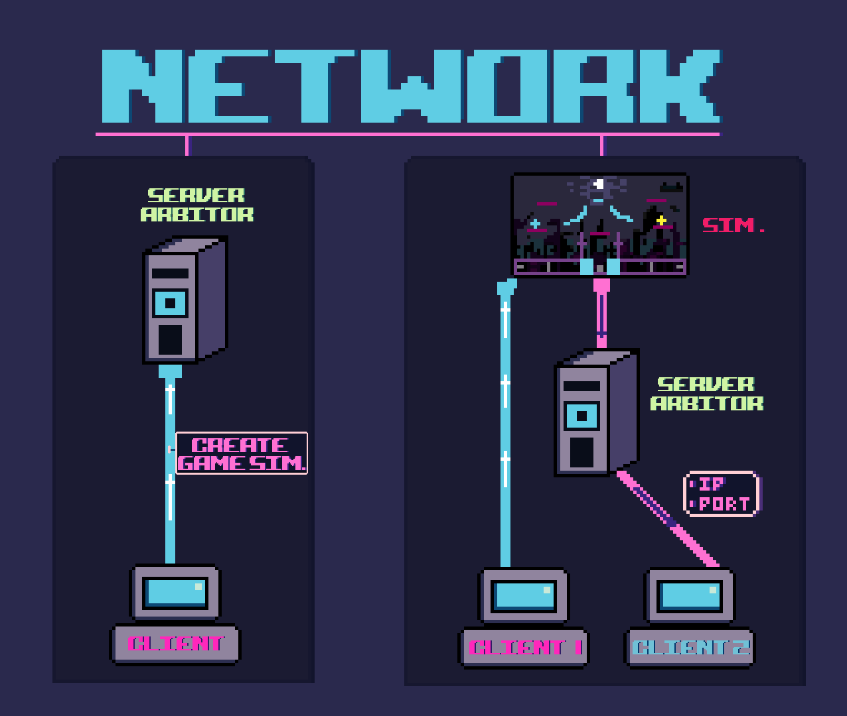

Slide 15
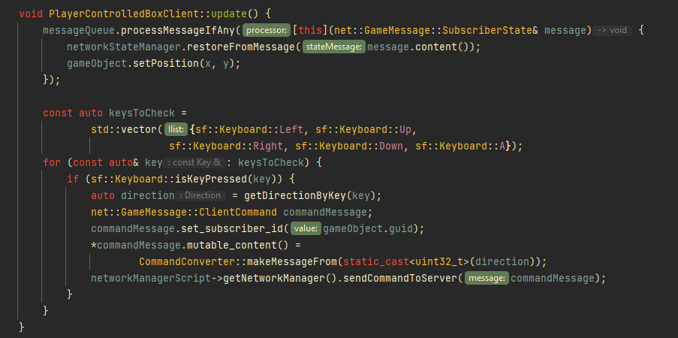

Slide 17
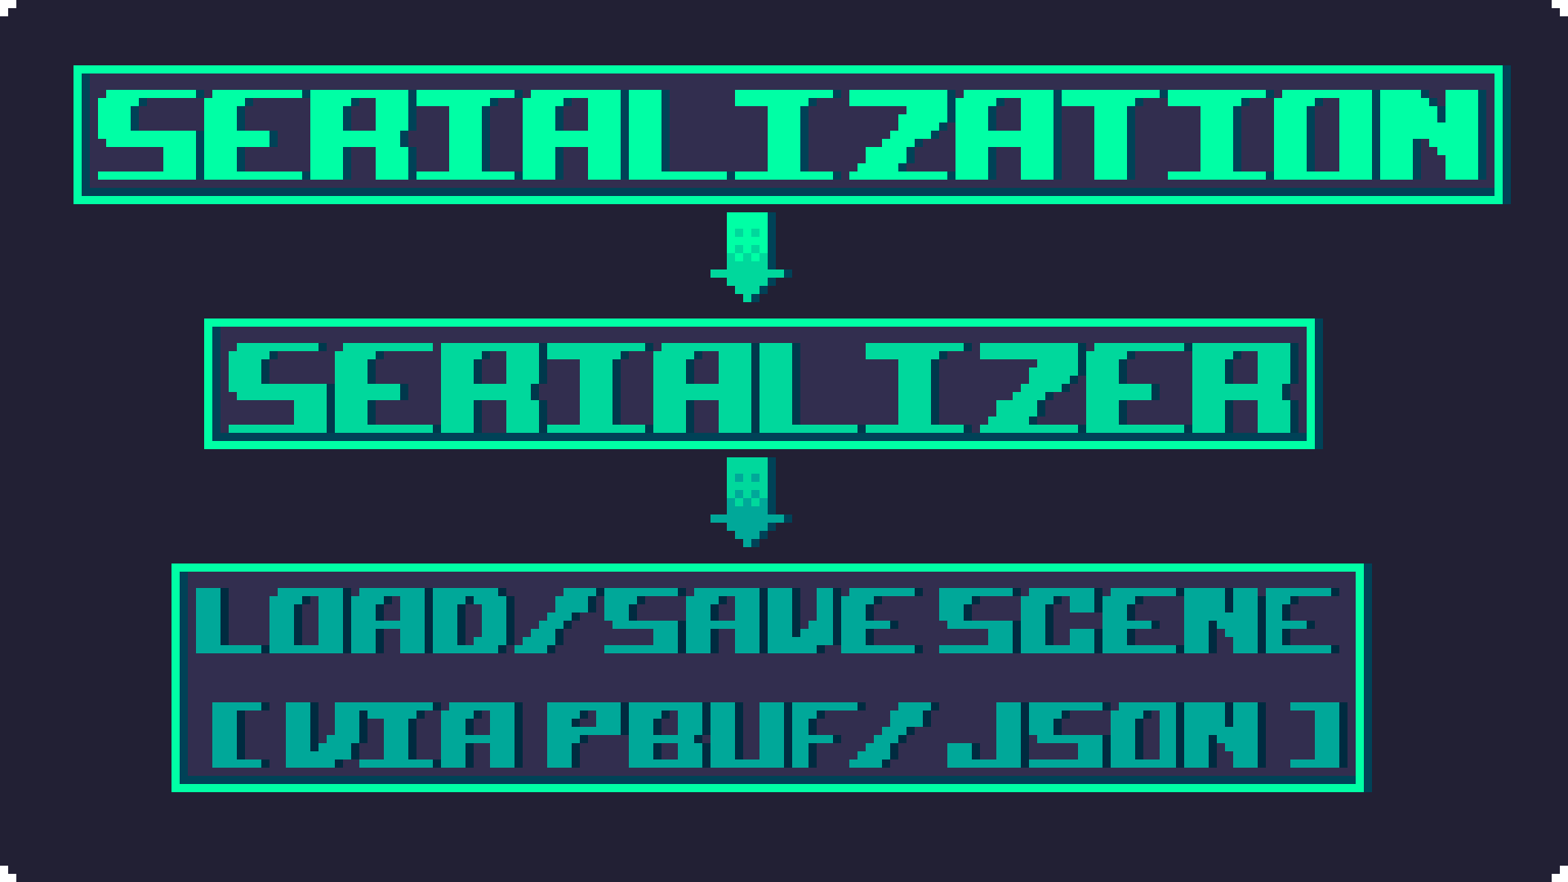

Slide 18
Patterns

Slide 19
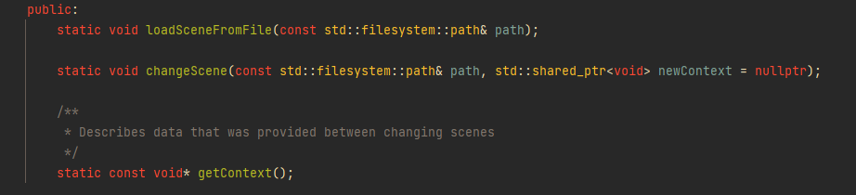
Context pattern
We need this to provide information between scene changes.

Slide 20
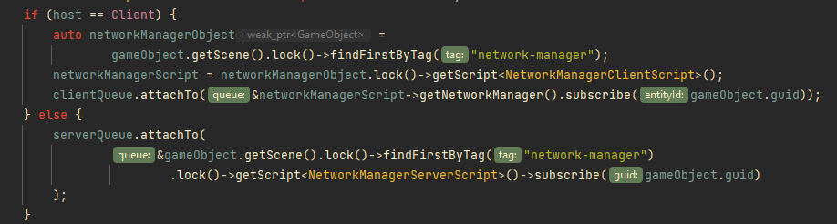
Pub/sub
We need this for scripting AND for network architecture.
In network architecture, game objects subscribe for updates from their related objects on other game’s instances (server and clients).

Slide 21
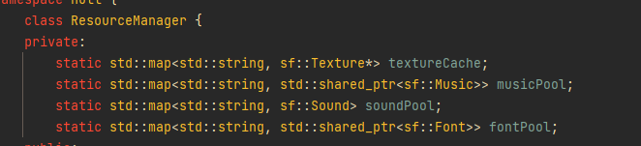
Object pool
We use this for cache

Slide 22
Object pool
We use this for cache

Slide 23
Factory method
We use this to dry code

Slide 24

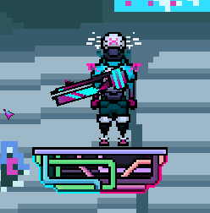
Dependency injection
We use it in scripting so that players can interact with with some other abstract object they don’t know details about

Slide 25
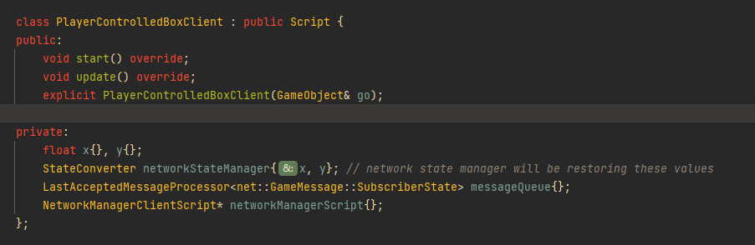
Declarative programming
We use it in some of our scripts so that net-code is written easier

Slide 26


Slide 27

Serialization - a lot of work needs to be done to make writing the serialization code easier and also writing this kind of code related to existing Scripts
Networking - choosing on a network architecture, as well as providing a decent library and at the same time using it to develop network scripts.
Architectural decisions such as abstracting GameObject from box2d’s RigidBody

Slide 28


Slide 29


Slide 30


Slide 31














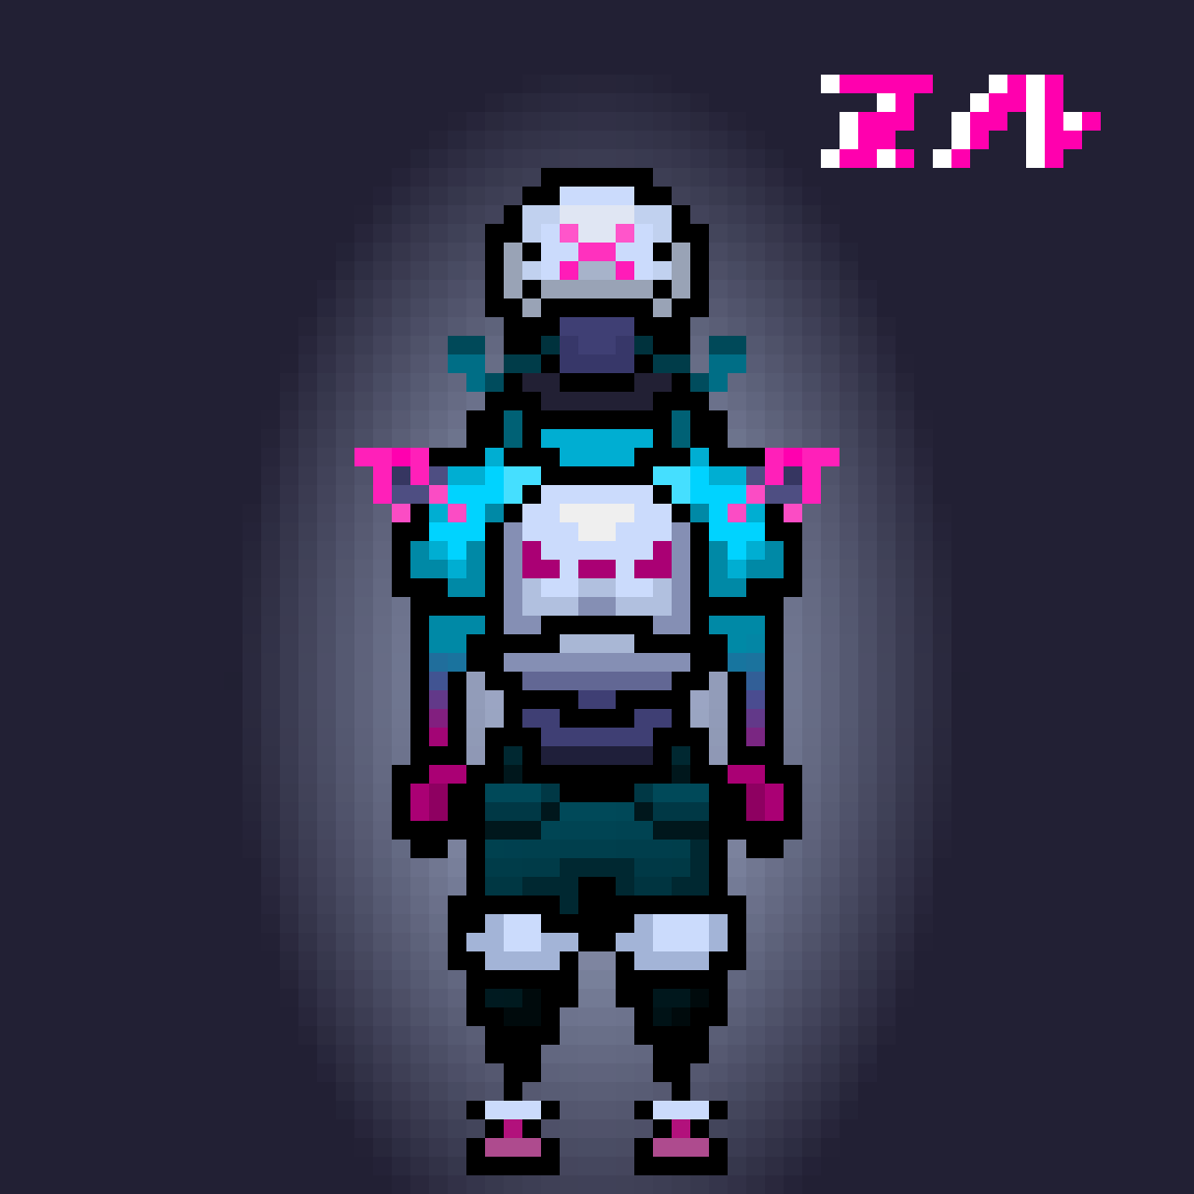



Slide 32


Slide 33
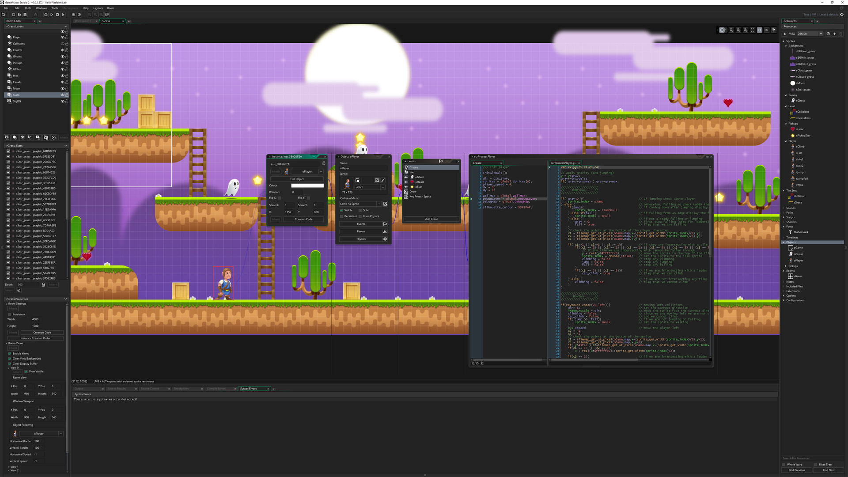
Heavily abstracted serialization
Level builder with a GUI
=> project is usable to anyone
Network optimization
More levels and more sophisticated gameplay
What we wanted to develop but did not succeed: Level builder with a GUI
Reason: complicated time-consuming task, which depends on (de)serialization, which itself was challenging

Slide 34


